Slide 1




ReNew GreenTech Hackathon
in association with
By Joju shaji

Slide 2
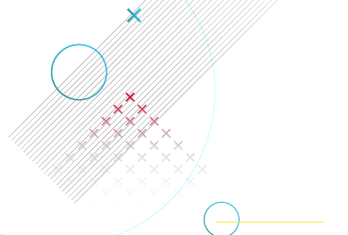
Results and recommendations
Based on the results of the model and data provided, what are some useful recommendations you can make?
Talk about important features, important engineered features, relations of target variable with other features, any predictive patterns. Conclude with model train, validation and test accuracy
Used xgb algorithm for the model building
The 5 most important features according to the model are t_diff_1 , nacelle_temp,reactive_power_calculated_by_converter,
Full_temp and ambient_temp columns.
Among these t_diff_1 and full_temp are feature engineered columns
Constructed 6 feature engineered columns those are t_diff_1=nacelle_temp - ambient_temp(temp diff between nacelle and outside)
We can easly estimate the bearing temperature by looking at the difference between outside temperature and nacelle temperature.
Nacelle_temp(imp feature) ,temperature at the part which is close to the rotor(so target dependent on that column)
t_diff_2=nc1_inside_temp - nacelle_temp , ncl_t = (nc1_inside_temp+ nacelle_temp)/2 , tot_temp=(nc1_inside_temp+ nacelle_temp+ambient_temp)/3 , full_temp = (generator_winding_temp_max + tot_temp)/2 , RPM =(60*winding_speed_raw*6)/pi*10

Slide 3
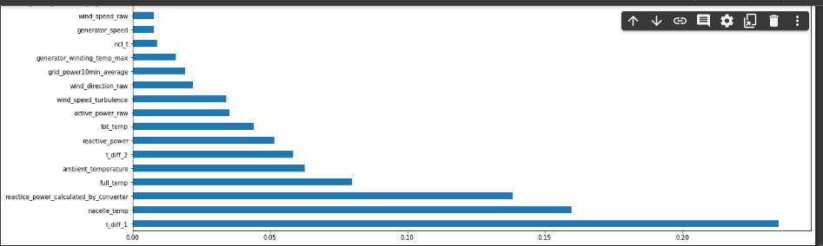
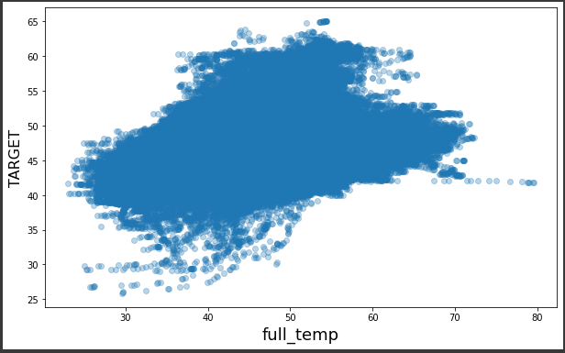
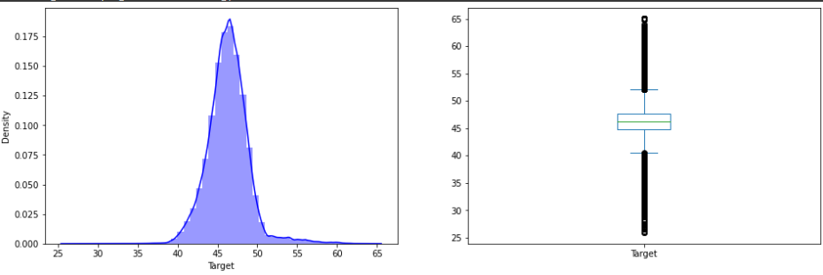
There was some liner relataionship between the temperature columns and target column ,but some non linearity is also present
During eda find out the distribution difference in each turbine_id ,so i divide the dataset into each 15 training set for each turbine id and trained the 15 models
And predict it according to the divided data in the test set ,this give me accurate score than any other approach ,test public score : 0.01171, validation :0.83(10% of each dataset ,used as val data ,there mean)
Feature importance plot (1.0) plot(target vs full_temp)
Target plot(1.2)

Slide 4
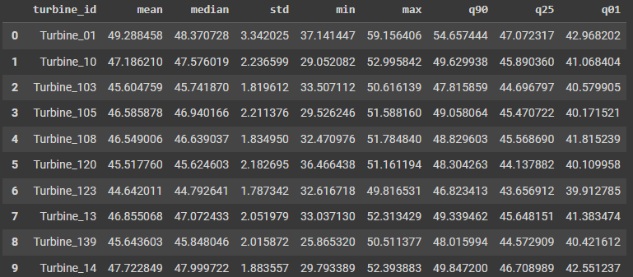
Data Understanding
List out the steps you took to understand the data
Write the steps in order. This should include:
Distribution of target variable
Any data treatment to non-missing or non-outlier data
Any other point observed
The target column is normally distributed ,we can see skewed distribution(both sides) ,since we are using ensampling tree model its not a problem.(image1.2)
There is no missing data
Only data treatment is done is label encoding of turbine_id column.
Observed points:
The distribution difference of target column for each turbine_id column
The bearing temperature will be high for some more time even the turbine is slowing down after continuous working
If the outside temperature is high the speed of generator is controlled.
The distribution of target for each turbine_id

Slide 5
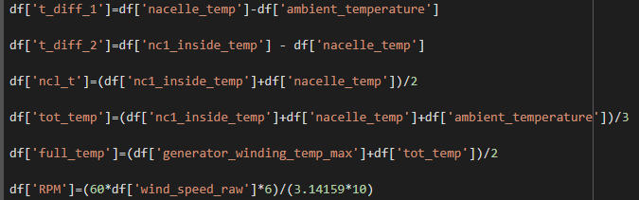
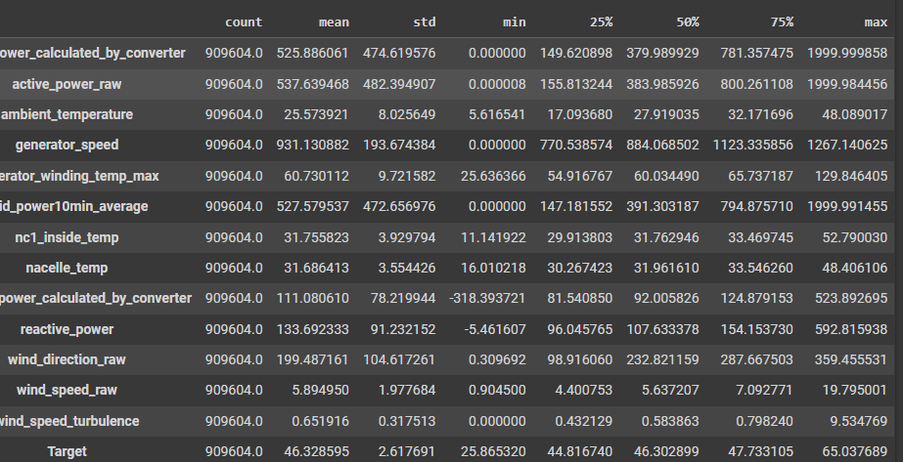
Data Preparation
Before fitting your model, what processing did you perform?
Write the steps in order. This should include:
Methodology used to detect and eliminate missing values and outliers
Any features you created out of data
Any data filtering (row filtering or column filtering) made
Any other changes
No missing values present
6 additional features created out of the dataset(check img in the side)
Labelencoding on column turbine_id
Sampling (stratified sampling) dataset divided into 15 subsamples according to the turbine_id and trained 15 model and predict the test accordingly .

Slide 6
Model Building & Evaluation
Specify which model you are using in your final model along with data and features being used
This should include:
Model name and its hyperparameters
Whether any tuning was performed
Feature importance (may not necessarily be derived from the same model)
Anything else you would like to mention
xgb(xgboost algorithm ) ,hyperparameters : learning_rate': 0.07646786074040168, 'reg_lambda': 0.3825339849703592, 'reg_alpha': 3.2850080831774475e-08, 'subsample': 0.952341741430891, 'colsample_bytree': 0.807732432187113, 'max_depth': 23 'n_estimators':516
early_stopping_rounds=300
Hyperparameter tuning was done using optuna ,used one subsample of the dataset for which gived high mse score,used “eval_metrc”
And early_stoppinig for avoiding overfitting ,so n_estimators vary ,first i used 10% of each subsample for validation (eval_metric)
Which gived 0.01203,when used full data instead of validation got 0.01173 (best).(chance of overfitting)
Features used ['active_power_calculated_by_converter', 'active_power_raw', 'ambient_temperature', 'generator_speed', 'generator_winding_temp_max', 'grid_power10min_average', 'nc1_inside_temp', 'nacelle_temp', 'reactice_power_calculated_by_converter', 'reactive_power', 'wind_direction_raw', 'wind_speed_raw', 'wind_speed_turbulence', 't_diff_1', 't_diff_2', 'ncl_t', 'tot_temp', 'full_temp', 'RPM']

Slide 7
Which feature is the single most important feature for monitoring?
Any feature which should have been important based on data dictionary. Reason why you think it should be important
How does the feature impact the output?
What can ReNew do to control and monitor this feature?
Remember! This feature may not be the top feature in feature importance
Features used : ['active_power_calculated_by_converter', 'active_power_raw', 'ambient_temperature', 'generator_speed', 'generator_winding_temp_max', 'grid_power10min_average', 'nc1_inside_temp', 'nacelle_temp', 'reactice_power_calculated_by_converter', 'reactive_power', 'wind_direction_raw', 'wind_speed_raw', 'wind_speed_turbulence', 't_diff_1', 't_diff_2', 'ncl_t', 'tot_temp', 'full_temp', 'RPM']
Nacelle_temp which is the temperature of nacelle(it is a cover close to the rotor) so it has some impact at the target,
The column is linearly dependent on the target column(somewhat not fully)
The time at which the turbine is working or not working should be monitored ,even the turbine is not running ,the bearing temp will be high if
It is running before some time ago

Slide 8
Which features are not affecting/have negligible effect on target temperature ?
You can mention least important features and try to explain why there did not come out as important
Any feature that is important but its presence is causing a decline in model accuracy
Were they supposed to be important? Can something be done to increase their importance?
RPM column which is created from winde_speed column(multiply by constants) is one of the least important feature,because the winde_speed_raw is also
Less importent by the model , because sometime if the winde speed is too low or too high the chance of turbine spinning is very low .when avg wind speed is less than 3 turbine will not run,and if it is higher than 20 ,they will shut down it due to damage
nc1_inside_temp :temperature inside nacelle,is also considered as less impact feature, because the temp inside nacelle is mainelly dependent on the generators running inside it ,but rotor is outside nacelle so there may be less dependency on it

Slide 9
Which month gives us the highest accuracy and which month is giving the lowest accuracy and why?
Low Accuracy:
Is the reason constant data? Missing values? Lower/higher number of data points? Presence of outliers? Temperature? Any other complexity?
High Accuracy:
Is there any trend? Lower/higher number of data points? Bias in data? Temperature?
Bonus points if you can identify any business reason
Low accuracy : because some times the generator speed is low (not working) the rotor temp will be high because the rotor temperature will continue for some more time even the rotor is not spinning ,
Also even the temperature is average the rotor temperature will be high , we can see these effect for rows where the target value is greater than 55, these is because the rotor is spinning for long time and generator is also spinning very fast ,combining the overall the temperature very high so the target temperature also become high
It is very difficult to say the turine is just started spinning , or is slowed down after a long run ,the first cast the rotor temp will be low,ni second case the rotor temp will be high ,
Also the different turbines are having different features like(some times there rotor length or turbine hand length will be different) so we can see some difference in their rotor temp distribution.
We can fully cut off the turbine even there is wind ,also when the temp is high outside if the turbine is not running for long rotor temp will be low.
High accuracy: the nacelle_temp : temp outside nacelle which is the closest part to the rotor so, we can see their values are some what connected

Slide 10
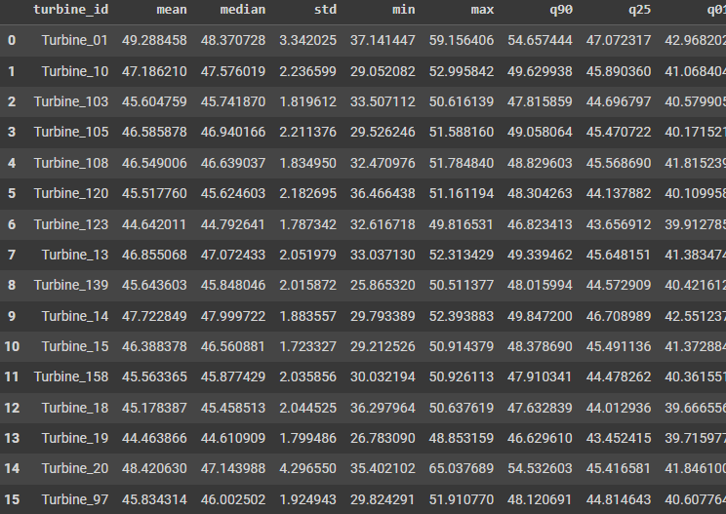
Which Turbine has the most variation in target temperature?
Define how you can define variation in target variable
Based on that definition, explain which turbine has highest variation in training data
The standard deviation of the target var iis 2.61 the max value is 65 and min value is 25 with a mean of 46
There are 15 different turbines ,there is chance that these turbine may have different character lke size of blade and rotors ,so there rotor temperature
Also may vary according to the turbine , check the img in the side
Turbine_20 has most variation with std value 4.29 ,also while model building
These subsample turbine_20 give high mse value ,these is because of that
Var in the data Turbine_20 and turbine_01 both give bad mse values
Comparing to the other turbines mse values
These has affect in all data

Slide 11
How can ReNew predict failure of a component by looking at target temperature and prevent such failures before they happen?
If there are abnormal changes (sudden spike or sudden drop which do not fall back to normal levels) then it can be indicative of a failure. Define a process to predict such failures before they happen
If the temperature indicators like outside nacellle temp or outside or atmosphere temp is very high we can to control the speed of the turbine
In order to cool the system down .also when there is high speed like more than 20m/s (threshold value according to the turbine shut the turbine down to avoid damage due to harsh wiind_turbulance,
If the power produced is very high for very long time slow it down to avoid damages

